Slide 1
Digital Portfolio
STUDENT NAME: VETHAVALLI
REGISTER NO AND NMID: 24724U09042 AND FA74CA345A84CB28BEC48F0EA814648A
DEPARTMENT: BCA
COLLEGE: CHEZHIAN ARTS AND SCIENCE COLLEGE FOR WOMENS/THIRUVALLUVAR UNIVERSITY

Slide 2
PROJECT TITLE DIGITAL PORTFOLIO

Slide 3


AGENDA
Project statement
2.Project Overview
3.End Users
4.Tools and Technologies
5.Portfolio design and Layout
6.Features and Functionality
7.Results and Screenshots
8.Conclusion
9.GitHub Link
3/21/2024 Annual Review

Slide 4

PROBLEM STATEMENT
In today’s digital world, students, job seekers, and freelancers need a platform to showcase their skills, projects, and achievements in a professional way. Traditional resumes are static and fail to reflect creativity. Hence, a digital portfolio is essential to highlight personality, technical skills, and work samples interactively.

Slide 5

PROJECT OVERVIEW
This project is a Digital Portfolio Website developed using HTML, CSS, and JavaScript .It is designed to present personal details, skills, projects, and achievements in an attractive and responsive way. The portfolio will act as a personal branding tool for career opportunities, internships, and freelance projects.

Slide 6

WHO ARE THE END USERS?
Students – to present academic achievements and projects
Job Seekers – to showcase skills, experience, and professional profile
Freelancers – to highlight their services, work samples, and client testimonials

Slide 7

TOOLS AND TECHNIQUES
HTML – For creating the structure of the portfolio
CSS – For styling, design, and responsive layout
JavaScript – For interactivity and dynamic features
GitHub – For hosting and sharing the project

Slide 8
POTFOLIO DESIGN AND LAYOUT
Home Section – Introduction and personal branding About Section – Academic background and career objectives Skills Section – Technical skills with visual progress bars or icons Projects Section – Details of projects with screenshots and descriptions Resume Section – Resume download option Contact Section – Contact form and social media links
8

Slide 9
FEATURES AND FUNCTIONALITY
Fully responsive design (works on mobile, tablet, laptop) Attractive UI with animations Resume download option Contact form with message field Project showcase with live demo links or screenshots Social media integration (LinkedIn, GitHub, etc.)

Slide 10

RESULTS
The portfolio is successfully designed and deployed. Screenshots of the Home Page, Skills Section, Project Section, and Contact Form can be shown. The portfolio looks professional and user-friendly, highlighting personal achievements effectively.
3/21/2024 Annual Review
10

Slide 11
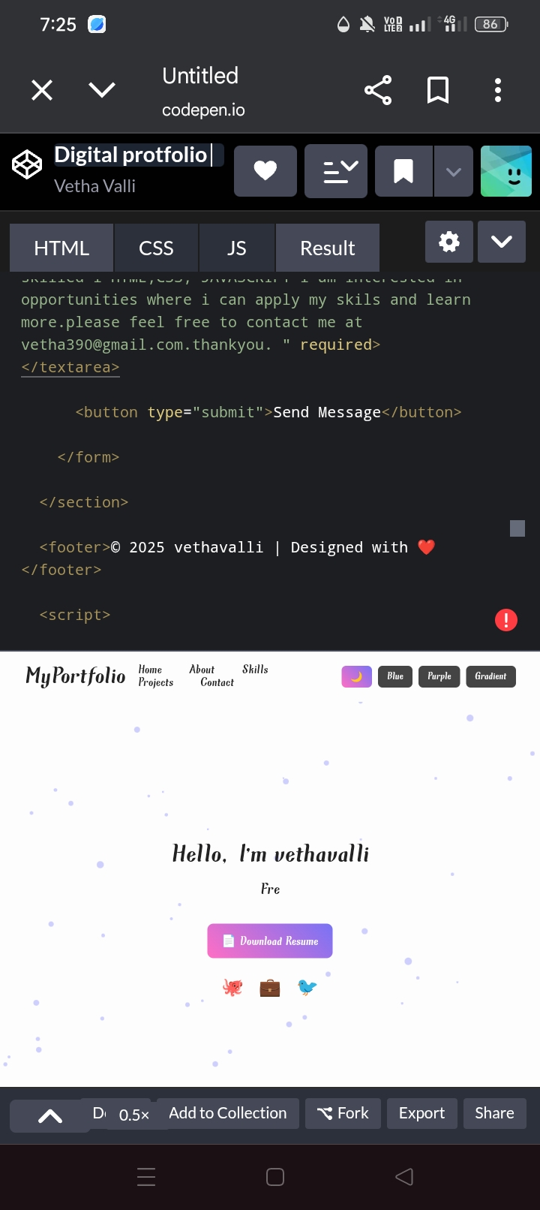
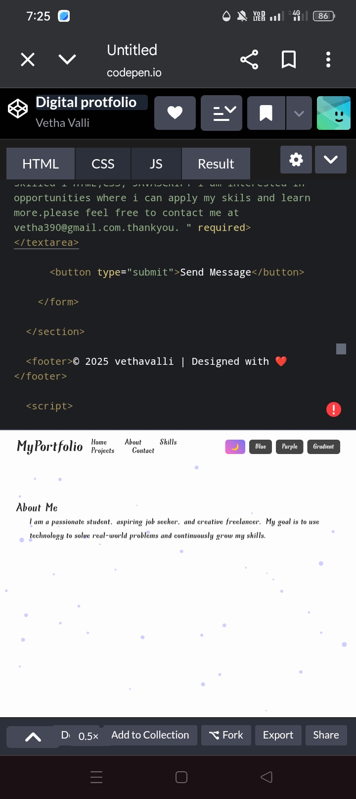
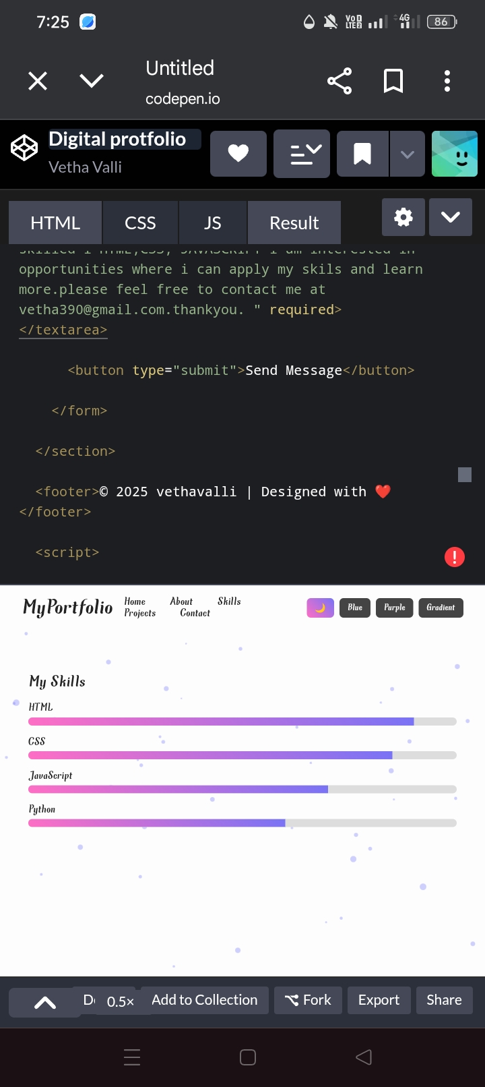
SCREENSHOTS
3/21/2024 Annual Review
11

Slide 12
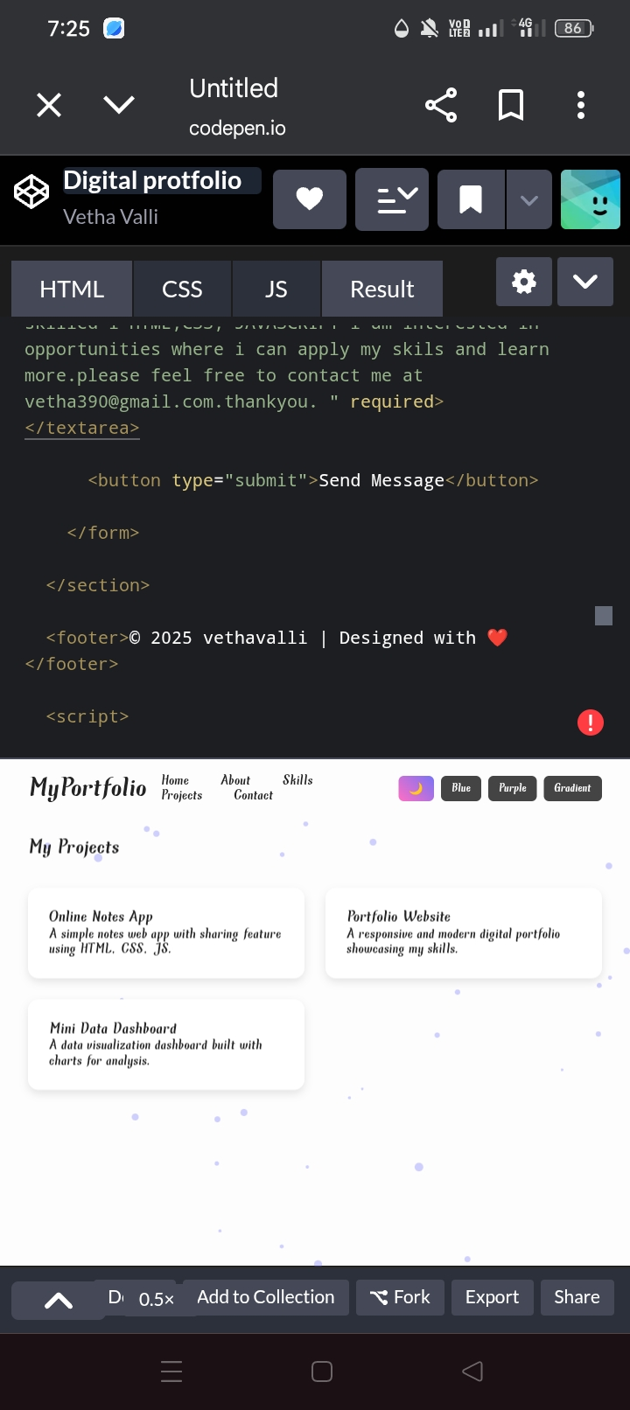
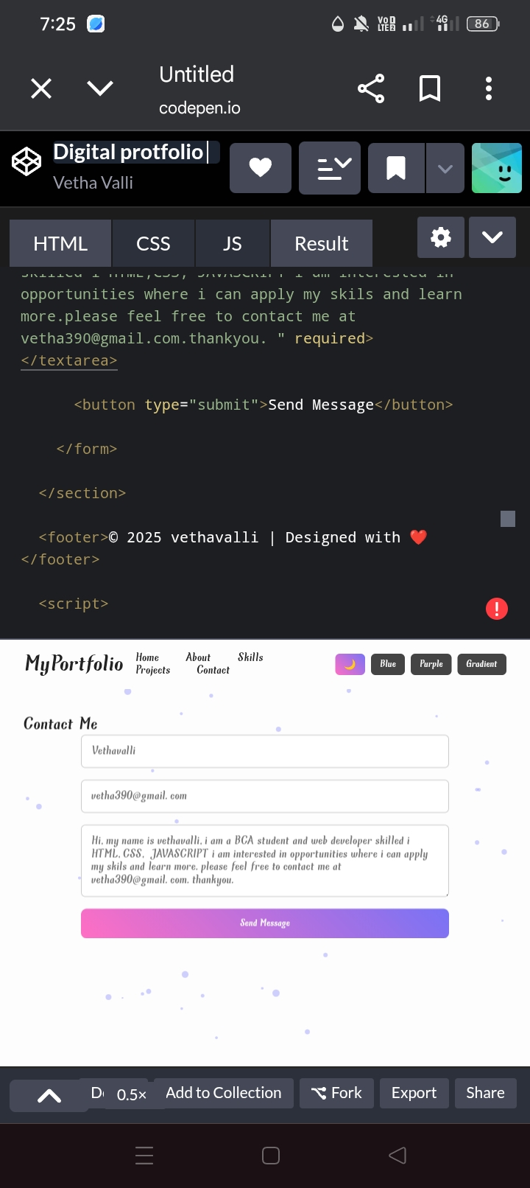
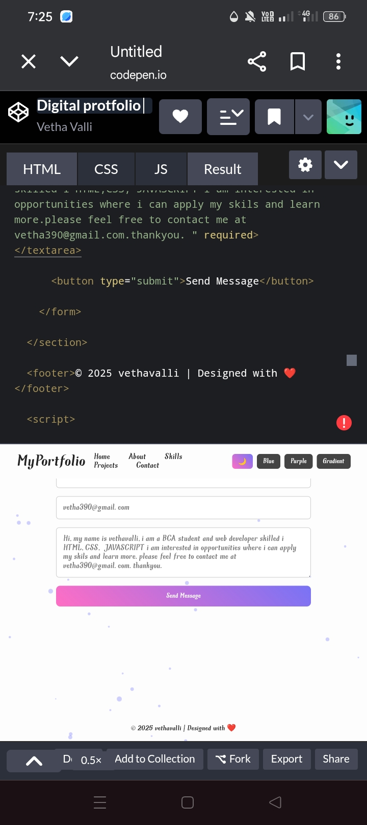
SCREENSHOTS
3/21/2024 Annual Review
12

Slide 13
CONCLUSION
This project helped in understanding front-end development concepts using HTML, CSS, and JavaScript. It is useful for students and professionals to build their digital presence.The portfolio will act as a personal branding tool and improve career opportunities.
13

Slide 14
GITHUB LINK
A GitHub repository has been created to host the project code
https://github.com/vetha-valli/Digital-protfolio-/tree/7e14840774a55dc44247c5907bf1af20f061d2fb

